Slide 1
Group 5.
Members;
1.ASHIMWE Rushinga Cedrick.
2.INEZA Gakwaya Ghislain.
3.ISHIMIRWE Jean de la croix.
4.FUMBA Huriro.
5.TSETOU Dede Henriana.

Slide 2
Semiconductor memory.
what is Semiconductor Memory?
Semiconductor memory is a type of semiconductor device tasked with storing data. There are two electronic data storage mediums that we can utilize, magnetic or optical.
Magnetic storage:
Stores data in magnetic form.
Affected by magnetic fields.
Has high storage capacity.
Doesn't use a laser to read/write data.
Magnetic storage devices are; Hard disk , Floppy disk, Magnetic tape etc.

Slide 3
Optical storage:
Stores data optically, uses laser to read/write.
Not affected by magnetic fields.
Has less storage than a hard disk.
Data accessing is high, compared to a floppy disc.
Optical storage devices are; CD-ROM,CD-R, CD-RW, DVD etc.
There is also volatile memory. This is memory that loses its data once power is cut off, while non-volatile memory retains data even without power.

Slide 4
Types of semiconductor memory.
Semiconductor Memory Types
* RAM (Random Access Memory) : Enables Read/Write of stored contents
ROM (Read Only Memory) : Allows only Read operation.
There is also volatile memory. This is memory that loses its data once power is cut off, while non-volatile memory retains data even without power.

Slide 5
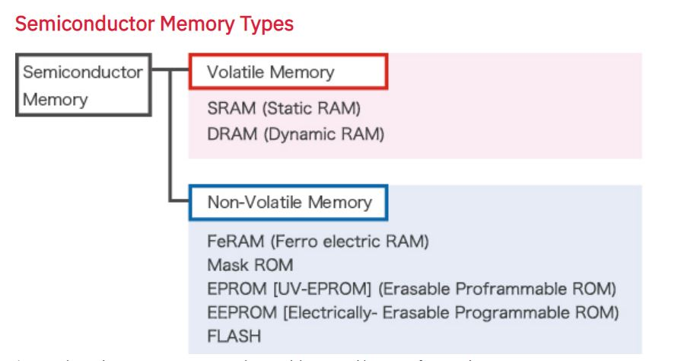
As explained in this diagram;

Slide 6
THE RAM and THE ROM.
What is the Difference Between RAM and ROM?
RAM, which stands for random access memory, and ROM, which stands for read-only memory, are both present in your computer.
RAM is volatile memory that temporarily stores the files you are working on. ROM is non-volatile memory that permanently stores instructions for your computer.

Slide 7
What is computer RAM?
RAM is volatile memory, which means that the information temporarily stored in the module is erased when you restart or shut down your computer.
Because the information is stored electrically on transistors, when there is no electric current, the data disappears. Each time you request a file or information, it is retrieved either from the computer's storage disk or the internet. The data is stored in RAM, so each time you switch from one program or page to another, the information is instantly available. When the computer is shut down, the memory is cleared until the process begins again. Volatile memory can be changed, upgraded, or expanded easily by users.

Slide 8
What is ROM?
ROM stands for non-volatile memory in computers., which means the information is permanently stored on the chip.
The memory does not depend on an electric current to save data, instead, data is written to individual cells using binary code. Non-volatile memory is used for parts of the computer that do not change, such as the initial boot-up portion of the software, or the firmware instructions that make your printer run. Turning off the computer does not have any effect on ROM.
Non-volatile memory cannot be changed by users.

Slide 9
Flash memory.
Flash memory, also known as flash storage, is a type of nonvolatile memory that erases data in units called blocks and rewrites data at the byte level.
Flash memory is widely used for storage and data transfer in consumer devices, enterprise systems and industrial applications. Flash memory retains data for an extended period of time, regardless of whether a flash-equipped device is powered on or off.
Flash memory is also used for in-memory computing to help speed performance and scalability of systems that manage and analyze large sets of data.

Slide 10
NOR vs. NAND flash memory
There are two types of flash memory: NOR and NAND;
NOR and NAND flash memory differ in architecture and design characteristics.
NOR flash uses no shared components and can connect individual memory cells in parallel, enabling random access to data.
NOR flash is fast on data reads, but it is typically slower than NAND on erases and writes.
A NAND flash cell is more compact and has fewer bit lines, stringing together floating gate transistors to increase storage density.
NAND is better suited to serial rather than random data access.

Slide 11
THANK YOU!!!

